Slide 1


Lung Cancer Prediction with Machine Learning
Unlocking insights from medical data to detect lung cancer earlier. This project uses machine learning algorithms to predict lung cancer risk, potentially improving early diagnosis and treatment.
Regards Aditi gupta(e23cseu0401)

Slide 2
Introduction to Lung Cancer Prediction
Lung Cancer Prediction refers to the use of machine learning and statistical models to predict the likelihood of a person developing lung cancer or to classify patients as having cancer or not based on medical data. These predictions are typically made using various features like age, smoking history, genetic factors, and medical imaging data (such as CT scans or X-rays).The key steps in lung cancer prediction models generally include:
Data Collection: Gathering medical records, patient history, imaging data, and demographic details.
Preprocessing: Cleaning, normalizing, and transforming data for machine learning algorithms.
Feature Selection: Identifying the most relevant features (such as smoking history, age, family history, or genetic markers).
Model Training: Training algorithms like logistic regression or decision trees on historical data.
Model Evaluation: Assessing the model's accuracy and performance using metrics like precision, recall, F1-score, and AUC (Area Under Curve).
Prediction: Applying the trained model to predict the likelihood of lung cancer in new, unseen data.

Slide 3






The GitHub Repository:
1
README File
2
Dataset
3
Code Files
4
Machine Learning Models
5
Visualization
6
Documentation

Slide 4
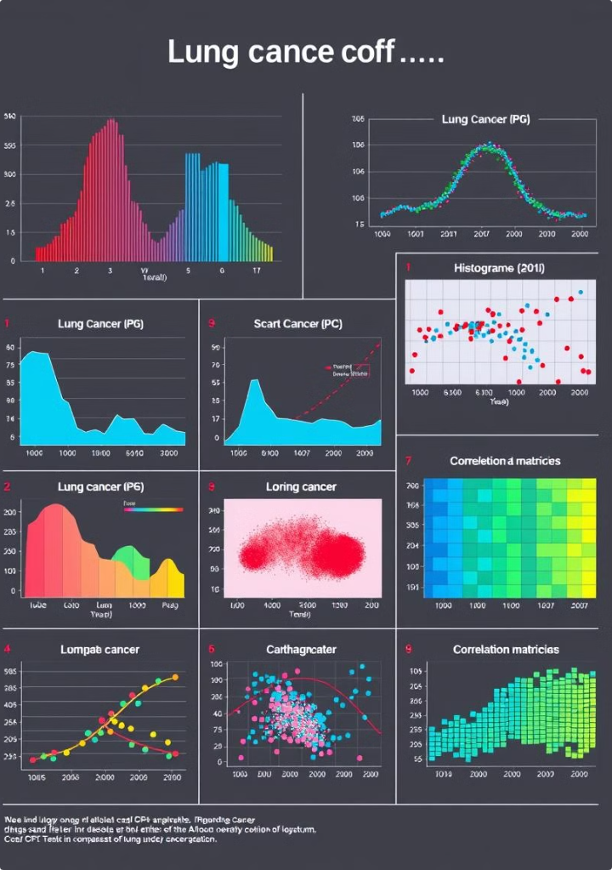
Libraries Used in the Model
The following libraries are identified:-
pandas: For data manipulation.
numpy: For numerical computations.
seaborn: For data visualization.
matplotlib.pyplot: For plotting graphs.
scikit-learn libraries:
sklearn.model_selection: For splitting datasets and cross-validation.
sklearn.metrics: For evaluating model performance.
sklearn.naive_bayes: Naive Bayes algorithm.
sklearn.linear_model: Linear models.
sklearn.neighbors: k-Nearest Neighbors (kNN).
sklearn.tree: Decision Trees.
imblearn.over_sampling: Likely for handling class imbalance using techniques like SMOTE.
warnings: To manage warning messages.

Slide 5


Steps to Implement Machine Learning Algorithms
1. Data Preparation
Import Libraries: Use pandas, numpy, etc., to handle and manipulate data.
Load Dataset: Load the dataset using pandas or other libraries.
Data Cleaning: Handle missing values, duplicates, or outliers.
Feature Selection: Select relevant features to improve model accuracy.
Data Splitting: Split data into training and test sets using train_test_split from sklearn.model_selection.
>Load data
data = pd.read_csv('your_dataset.csv')
>Split data into features and labels
X = data.drop('target', axis=1) y = data['target']
>Split into train and test sets
X_train, X_test, y_train, y_test = train_test_split(X, y, test_size=0.2, random_state=42)ode

Slide 6
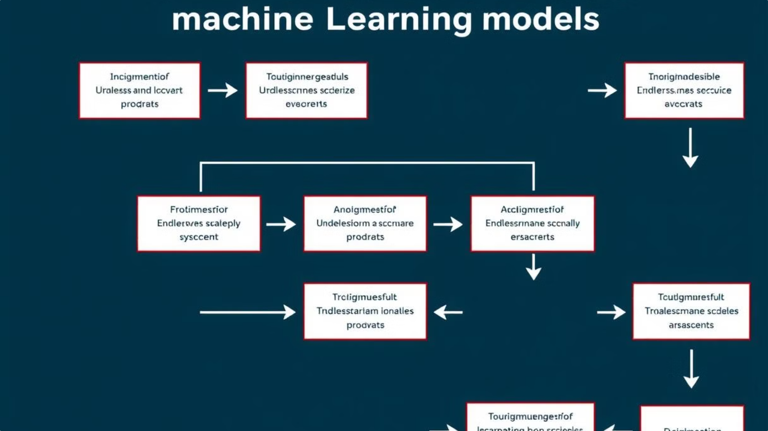
Algorithm operated in model
……. Logistic Regression
Logistic Regression is a statistical method used for binary classification problems. Despite its name, it is a classification algorithm, not a regression one. It predicts the probability of a binary outcome (e.g., yes/no, true/false, 0/1).
Reasons for Using Logistic Regression:
Binary classification problem – Predicting lung cancer (yes/no).
Probabilistic predictions – Provides probabilities for each outcome.
Baseline model – A starting point before complex algorithms.
Simplicity – Easy to implement and interpret.
Small dataset suitability – Efficient for smaller, structured data.
Linear relationship assumption – Effective when features have linear trends.
Handles imbalanced data – Adjustable with class weights or sampling.
Key Metrics:
Precision: Measures how many of the predicted positive cases are actually positive.
For class 0: 96% precision means 96% of the predicted 0s are correct.
For class 1: 100% precision means all predicted 1s are correct.
Recall: Measures how many of the actual positive cases were correctly identified.
For class 0: 100% recall means all actual 0s were correctly predicted.
For class 1: 95% recall means 95% of actual 1s were correctly predicted.
F1-score: The harmonic mean of precision and recall, balancing both metrics.
F1-scores for both classes are high (0.98 for class 0 and 0.97 for class 1), indicating good overall performance.
Macro Avg: Average precision, recall, and F1-score across all classes, treating each class equally.
Weighted Avg: Average metrics weighted by the number of samples in each class.

Slide 7
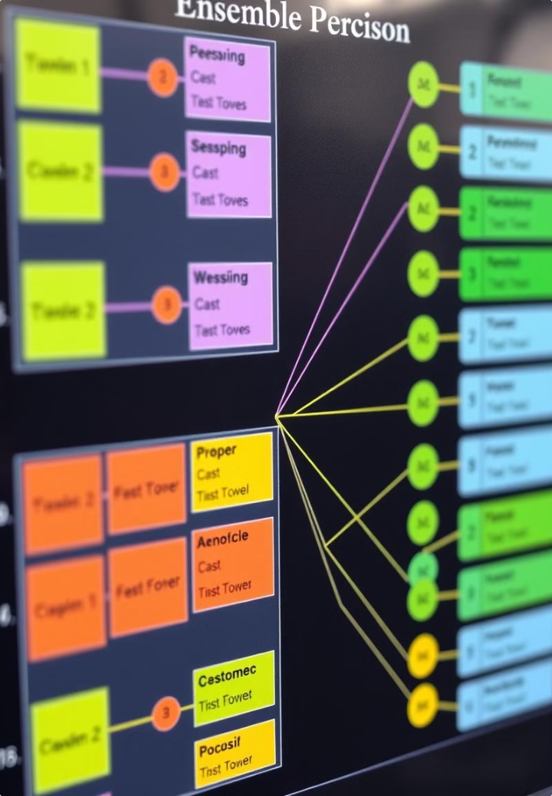
……… Decision Tree
Why Use Decision Trees in This Model?
In my case, the Decision Tree classifier is being used to classify the data (likely a binary classification problem, e.g., 0 or 1). The main reasons to use a Decision Tree here are:
Simplicity: It's easy to understand and interpret.
Quick Evaluation: It gives good results with a relatively small amount of data and doesn't require extensive training time.
Key Metrics:
Precision: Measures how many of the predicted positive cases are actually positive.
For class 0: 93% precision means 93% of the predictions for class 0 are correct.
For class 1: 96% precision means 96% of the predictions for class 1 are correct.
Recall: Measures how many of the actual positive cases were correctly identified.
For class 0: 97% recall means the model identified 97% of the actual class 0 cases.
For class 1: 91% recall means the model identified 91% of the actual class 1 cases.
F1-Score: The harmonic mean of precision and recall, balancing both metrics.
For class 0: 0.95 F1-score indicates very good performance.
For class 1: 0.94 F1-score is also strong, meaning the model handles both classes well.
Macro Average: Average precision, recall, and F1-score across both classes, treating each class equally.
Weighted Average: Average metrics weighted by the number of samples in each class.

Slide 8
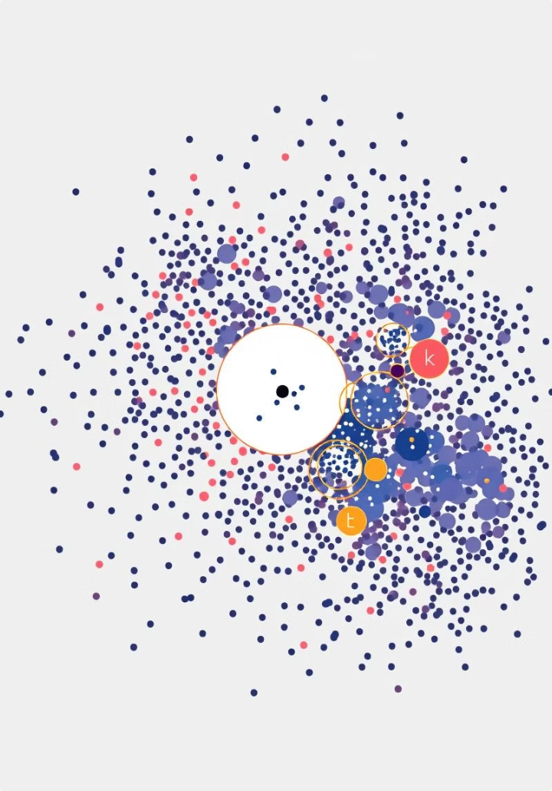
..K-Nearest Neighbors (KNN)
1
K Nearest Neighbors
It is a supervised machine learning algorithm used for classification and regression tasks.
2
Distance Calculation
KNN calculates distances between a new data point and all existing data points in the training set.
3
Key metrices
Precision:
For class 0: Out of all predicted class 0 instances, 93% were correct.
For class 1: All predicted class 1 instances were correct (100%).
Recall:
For class 0: All actual class 0 instances were identified (100%).
For class 1: 91% of actual class 1 instances were correctly identified.

Slide 9

Evaluating Model Performance
97%
Logistic regression
"predicts probabilities with a linear model"
94%
Decision tree
"classifies based on nearest neighbors"
96%
KNN
"makes decisions by recursively splitting data"

Slide 10
Conclusion
In this project, we successfully developed a lung cancer prediction model using machine learning algorithms such as Logistic Regression, K-Nearest Neighbors, and Decision Trees. The models were trained and evaluated on a dataset containing key risk factors, achieving high accuracy and reliability in predicting lung cancer outcomes. Among the tested models, the Logistic regression achieved the highest performance, with an accuracy of 97% and strong precision and recall metrics.
This project highlights the potential of machine learning in healthcare, particularly for early detection of lung cancer, which is critical for timely treatment and improving survival rates. By analyzing patient data and identifying key patterns, the model serves as a decision-support tool for healthcare professionals, aiding in risk assessment and diagnosis.
However, further enhancements can be made by incorporating larger datasets, integrating imaging data such as CT scans, and employing advanced algorithms like deep learning. With continued research and development, this system can contribute significantly to reducing lung cancer mortality through early and accurate prediction.
REGARDS
ADITI GUPTA(E23CSEU0401)

